Slide 1
TTC - Mestrado em Microbiologia APLICADA
IE - MESTRADO EM MATEMÁTICA APLICADA ECONOMIA & GESTÃO
ITT – Engenharia Biomédica e Biofísica
IE - OPCIONAL PARA 2º CICLO
AULA 9
06 MAIO 2019
FCUL – 2018/2019
Helena Vieira
Copyright ©

Slide 2
Sumário
O Business Plan
Projecções financeiras.
Risco versus benefícios.
Fontes de capital: 3Fs, business angels, capital de risco, banca.
BM Canvas:
Principais fontes de Custos.
Fontes de receita.
Pitching. A arte de “convencer”.

Slide 3
LET’S CREATE A COMPANY!
SHAREHOLDERS
Helena, Rita, Bruno
NAME
Emp. C., Lda.
EMPLOYEES
YOU!

Slide 4
BUSINESS PLAN
Executive summary
Opportunity/Problem
Solution
Competition
Financials
Team
Go to market

Slide 5
1
EXECUTIVE SUMMARY

Slide 6
2
OPPORTUNITY/PROBLEM
The problem you are solving
The opportunity you are creating
Who has this problem
For whom you are creating an opportunity
Quantify

Slide 7
3
SOLUTION
Your value proposition
Why it is unique
How you got here
Technology involved
Key partners and resources

Slide 8
4
COMPETITION
Other ways of solving the problem
Direct and indirect competition
Features comparison

Slide 9
5
FINANCIALS
Your business model
Forecasted sales
Fixed and variable costs
Your cash flows
Your investment needs
Your return on investment
Your business valuation

Slide 10
6
TEAM
Who they are
What the roles are
Why they are part of the team (added value)

Slide 11
7
GO TO MARKET
Strategy
Client acquisition
Advertising

Slide 12
The Financial Plan (1)
Basic for the evaluation of an investment opportunity
Represents your best estimates of financial requirements
Indicate venture’s potential and a timetable for financial viability
Operating plan for financial management

Slide 13
The Financial Plan (2)
Forecasted Sales (Previsão de Vendas)
Costs map (Fixed & Variable)
Cash-Flow (mapa de cash-flow ou fluxo de caixa)
Balance Sheet (balanço e balancete)
Profit and Loss forecast (DRN e DRF)
Pro-forma Income statements (income predictions)
Break-even chart (when you will turn positive…)
Payback Period
Annex the assumptions (sales levels and growth, inventory requirements, payable periods, cost of goods, inflation rates…)

Slide 14
FINANCIAL PLAN
Euros
EMP C., Lda | 2017 | 2018 | 2019 | 2020
Revenues
Net revenue | 0 | 1 000 | 5 000 | 15 000
Operating cost
R&D | 2 000 | 2 500 | 3 000 | 4 000
Sales & Marketing | 1 000 | 2 000 | 4 000 | 7 000
HR | 1 000 | 1 500 | 2 000 | 3 000
Total Cost | 4 000 | 6 000 | 9 000 | 14 000
Net Income | (4 000) | (5 000) | (4 000) | 1 000
Fund raising
Investment needs | 9 000

Slide 15
Balance Sheet
Accounting document that expresses the patrimonial situation of a company at a specific point in time (see supporting docs)
Assets (Activo) (how much I have) and Liabilities (Passivo) (how much I owe)
Equity (Capital Próprio) (situação patrimonial Líquida)
E = A – L (CP = A – P)

Slide 16
BALANCE SHEET
Emp. C., Lda, 2017
Emp. C., Lda, 2018
STATIC VIEW
A snapshot of the company’s financial situation at a particular point in time.
Notes:
Typically 31st december

Slide 17
BALANCE SHEET
ASSETS | EUROS
Current Assets
Cash | 20 000
Accounts receivable | 15 000
Inventory | 150 000
Total Current Assets | 185 000
Non-current Assets
Plant and equipment | 50 000
Business permises | 650 000
Vehicles | 70 000
Total Non-Current Assets | 770 000
TOTAL ASSETS | 955 000
ASSETS
What a company owns
Notes:
Capitais próprios

Slide 18
BALANCE SHEET
ASSETS | EUROS
Current Assets
Cash | 20 000
Accounts receivable | 15 000
Inventory | 150 000
Total Current Assets | 185 000
Non-current Assets
Plant and equipment | 50 000
Business permises | 650 000
Vehicles | 70 000
Total Non-Current Assets | 770 000
TOTAL ASSETS | 955 000
LIABILITIES
Current Liabilities
Accounts payable | 25 000
Credit card debt | 45 000
Total Current Liabilities | 70 000
Non-Current Liabilities
Long term loan | 500 000
Total Non-Current Liabilities | 500 000
TOTAL LIABILITIES | 570 000
ASSETS
What a company owns
LIABILITIES
What a company ows
Notes:
Capitais próprios

Slide 19
BALANCE SHEET
ASSETS | EUROS
Current Assets
Cash | 20 000
Accounts receivable | 15 000
Inventory | 150 000
Total Current Assets | 185 000
Non-current Assets
Plant and equipment | 50 000
Business permises | 650 000
Vehicles | 70 000
Total Non-Current Assets | 770 000
TOTAL ASSETS | 955 000
LIABILITIES
Current Liabilities
Accounts payable | 25 000
Credit card debt | 45 000
Total Current Liabilities | 70 000
Non-Current Liabilities
Long term loan | 500 000
Total Non-Current Liabilities | 500 000
TOTAL LIABILITIES | 570 000
SHAREHOLDERS’ EQUITY | 385 000
ASSETS
What a company owns
ASSETS = LIABILITIES + SHAREHOLDERS’ EQUITY
LIABILITIES
What a company ows
SHAREHOLDER’S EQUITY
Sources of funds
Notes:
Capitais próprios

Slide 20
BALANCE SHEET
ASSETS | EUROS
Current Assets
Cash | 20 000
Accounts receivable | 15 000
Inventory | 150 000
Total Current Assets | 185 000
Non-current Assets
Plant and equipment | 50 000
Business permises | 650 000
Vehicles | 70 000
Total Non-Current Assets | 770 000
TOTAL ASSETS | 955 000
LIABILITIES
Current Liabilities
Accounts payable | 25 000
Credit card debt | 45 000
Total Current Liabilities | 70 000
Non-Current Liabilities
Long term loan | 500 000
Total Non-Current Liabilities | 500 000
TOTAL LIABILITIES | 570 000
SHAREHOLDERS’ EQUITY | 385 000
TOTAL LIABILITIES + SHAREHOLDERS’ EQUITY | 955 000
ASSETS
What a company owns
ASSETS = LIABILITIES + SHAREHOLDERS’ EQUITY
LIABILITIES
What a company ows
SHAREHOLDER’S EQUITY
Sources of funds
Notes:
Capitais próprios

Slide 21
Profit and Loss Statement
P&L is intended to demonstrate the aquisition of results for a certain amount of time, usually a year, a semester or a) quarter
It allows the evaluation of the economical performance of a venture
P&LF : P&L by function – production, commercial, administrative & financial
P&LN: P&L by Nature – homogenous groups by nature

Slide 22
PROFIT & LOSS STATEMENT
Profit & Loss
Emp. C., Lda
2018
Emp. C., Lda, 2017
Emp. C., Lda, 2018
DYNAMIC VIEW
Financial results achieved over a period of time.

Slide 23
PROFIT & LOSS STATEMENT
 | EUROS
Revenues | 124 000
Operating and maintenance costs | 105 600
OPERATING MARGIN | 18 400
Notes:
Capitais próprios

Slide 24
PROFIT & LOSS STATEMENT
 | EUROS
Revenues | 124 000
Operating and maintenance costs | 105 600
OPERATING MARGIN | 18 400
Depreciation | 12 500
OPERATING INCOME | 5 900
Notes:
Capitais próprios

Slide 25
PROFIT & LOSS STATEMENT
 | EUROS
Revenues | 124 000
Operating and maintenance costs | 105 600
OPERATING MARGIN | 18 400
Depreciation | 12 500
OPERATING INCOME | 5 900
Interest expense | 2 000
EARNINGS BEFORE TAXES | 3 900
Notes:
Capitais próprios

Slide 26
PROFIT & LOSS STATEMENT
 | EUROS
Revenues | 124 000
Operating and maintenance costs | 105 600
OPERATING MARGIN | 18 400
Depreciation | 12 500
OPERATING INCOME | 5 900
Interest expense | 2 000
EARNINGS BEFORE TAXES | 3 900
Tax expense | 1 600
NET INCOME | 2 300
EBITDA: Earnings Before Interest, Taxes, Depreciation and Amortization
EBIT: Earnings Before Interest and Taxes,
EBT: Earnings Before Taxes
Notes:
Capitais próprios

Slide 27
CASH FLOW STATEMENT
Cash flow
Statement
Emp. C., Lda
2018
Emp. C., Lda, 2017
Emp. C., Lda, 2018
DYNAMIC VIEW
Records the movement of money (in and out of a company), between two Balance Sheets.

Slide 28
CASH FLOW STATEMENT
 | EUROS
CASH FLOW FROM OPERATING ACTIVITIES
Cash receipts from customers | 124 000
Cash paid to suppliers and employees | (105 600)
Cash generated from operations | 18 400
Interest paid | (2 000)
Tax paid | (1 600)
Net cash flow from operating activities | 14 800
NET INCREASE/DECREASE IN CASH
Cash at the beginning of the period | 2 400
Cash at the end of the period | 17 200
Notes:
Capitais próprios

Slide 29
Money, Money, Money…
3F (Family, Fools and Friends)
BA (Business Angels)
VC (venture Capital)
Bank
Grants and government support

Slide 30
naeem@startup-advisor.com

Slide 31
Investments evaluation (or Investor’s talk!!)
Net present Value method (NPV = VAL)
opportunity cost and time value of money
Internal rate of return method (IRR = TIR)
the rate of interest you receive by putting your money into project

Slide 32
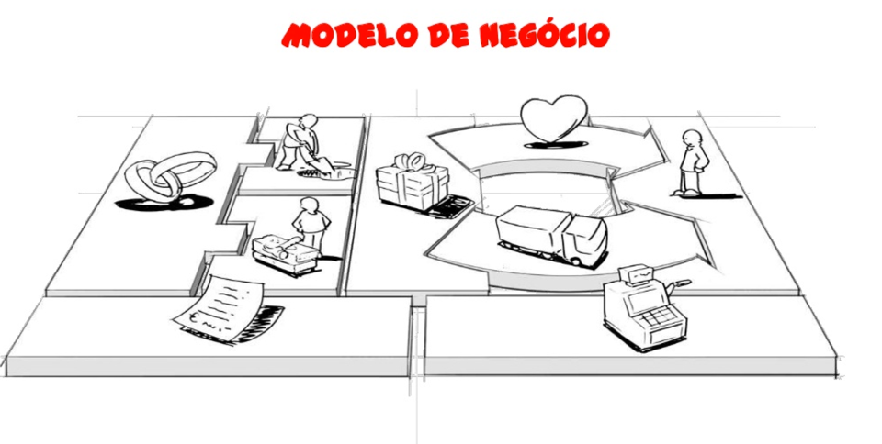
BUSINESS MODEL CANVAS

Slide 33
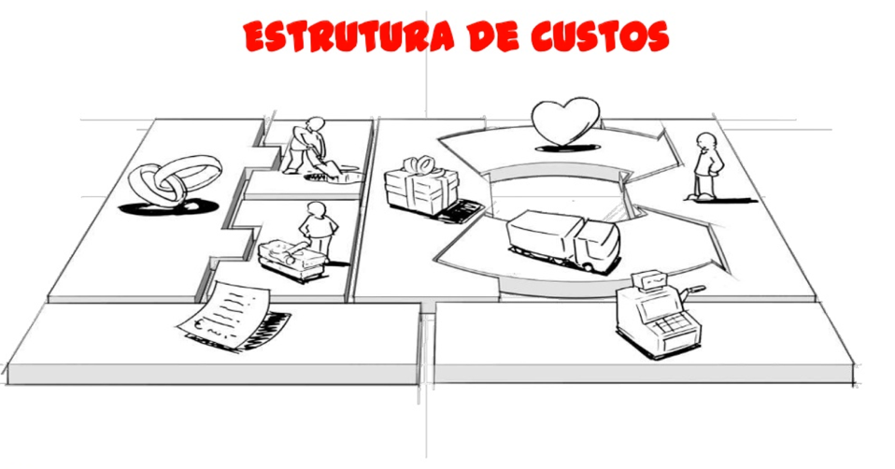
COST STRUCTURE

Slide 34
COST STRUCTURE
What is the resulting cost structure?

Slide 35
COST STRUCTURE
What is the resulting cost structure?
What are the resources with more impact on costs?

Slide 36
COST STRUCTURE
What is the resulting cost structure?
What are the resources with more impact on costs?
What are the most expensive activities?

Slide 37
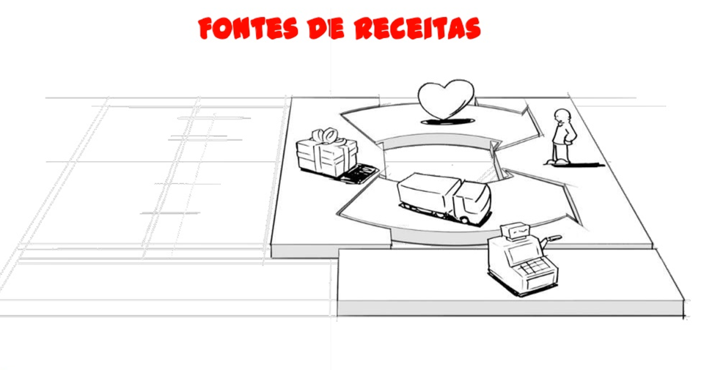
REVENUE STREAMS

Slide 38
REVENUE STREAMS
What type of revenue streams we can have?
What are our pricing models?
How much are the clients willing to pay?
What is the contribute of each stream to the total revenue?

Slide 39
THE ELEVATOR PITCH
The amount of time you have on an elevator ride to convince an investor/client of your great idea/product
Should be short and clear
Should be simple in language (NO TECH TALK!)
Should focus on USP
Should focus on advantages

Slide 40
GOAL

Slide 41
THE ELEVATOR PITCH

Slide 42
naeem@startup-advisor.com

Slide 43
naeem@startup-advisor.com

Slide 44
naeem@startup-advisor.com

Slide 45
naeem@startup-advisor.com

Slide 46
naeem@startup-advisor.com

Slide 47
naeem@startup-advisor.com

Slide 48
naeem@startup-advisor.com

Slide 49
naeem@startup-advisor.com

Slide 50
naeem@startup-advisor.com

Slide 51
naeem@startup-advisor.com

Slide 52
naeem@startup-advisor.com

Slide 53
naeem@startup-advisor.com

